Slide 1

Data Projects
Viran Gohil

Slide 2
-Credit Data- Logistic, C.45 Tree -Backgammon - Genetic Algo -Procurement Data - Multi-Class Text Classification -Demand Forecasting - Pre-processing advice -Minimum Viable Product - Employee Attrition -Azure Machine Learning - Training Course -Product Reviews - Perceptron -Digit Recognition - SVM, Multinomial Regression, PCA, Kernals, Neural, Fully Connected, Convolutional -Ratings - Unsupervised -Text-Based Game - Reinforcement

Slide 3
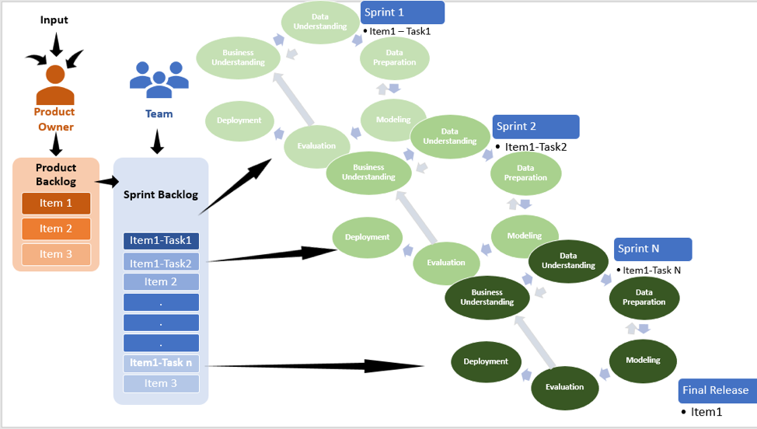
CRISP-DM, the Agile Way

Slide 4
Methodology-CRISP-DM
Business Understanding
Who are the stakeholders? What are their objectives? Can objectives be reconciled? Do they understand the risk? Can we get stakeholders to work together to agreement exact objectives?
Data Understanding
What have we got, what is important and what do we need to do to get it into a usable format? Structured, Unstructured, Batch, Stream, Pipelines.
Data Preparation
Cleansing, Wrangling, Featture Engineering.
Modelling
Automated hyperparamter tuning.
Evaluation
Deployment
Ongoining Managment

Slide 5
Project - Credit Data
Data Understanding and Preperation
Modelling
Logistic Regression
C4.5 - Divide and Conquer
Notes:
Classification if the mortgage status is in arrears OF three or more months 2 years after initial lending. Being in arreas is the label. Binary arears or not arrears,
Questions being asked of the data
-Is the response class balanced?
-Are outliers justfied?
-Exclude bias attributes?
-Are distributions justfied? - Do we need to transform the data log and square root.
-Do features make domain sense in terms of predictive prower? age of the property any information on arrears.
-Multi-colinearity? - high correlations among predictor variables, leading to unreliable and unstable estimates of regression
- Do we need to bin the data - helps with reducing noise or non-linearity, easy identification of outliers, invalid and missing values of numerical variables.
-Logistic Regression as the dependent variable is binary
-C4.5 - divide-and-conquer algorithm
attribute is a single class or the subset is small then the tree is a
leaf labelled with the most frequent class in the attribute. Otherwise, the
attribute is tested with two or more outcomes which generate branches
(subsets of the attribute) according
to the outcome of the test with the same procedure applied recursively.
-------------------------------------------------
ADVANATGES
C4.5 - variable screening; accept all forms of data, not concerned by missing values or sensitive to outliers as the splitting happens based on the proportion of samples within the split ranges and not on absolute values. ....trees are easy to interpret and explain.
However, high number of features with multiple partitions may create overfitting.
LR data requires pre-processing for outliers and extreme values to generate a stable model as it assumes there is a single smooth non-linear decision boundary, not necessarily parallel to the axis whilst decision tress can be applied to situations where there is not just one underlying decision boundary. Logistic regression has low variance so there is a lower chance of overfitting. Decision trees can be scaled up to be very complex but are more liable to over-fit. Pruning is applied to avoid this. Logistic regression is easier to interpret and there are lots of techniques developed to undertake subset selection or stepwise selection. Finally, when the feature dimensions gets large, it is very hard to interpret for trees.
EVALUATION
Regards evaluating the predictive performance of the classification models, four commonly used metrics
kappa, recall and precision and accuracy[15].
Kappa measures how well the classifier performed as compared to how well it would have performed simply by chance.
‘Observed Accuracy’ minus ‘Expected Accuracy’ divided by 1-Expected Accuracy.
Sensity. ‘recall’ or true positive rate of the model is the rate that the event of interest is predicted correctly for all samples having the event. It is measuring the accuracy in the event population.
The precision also known as positive predictive value tells us the probability that the sample is an event. i.e. When it predicts an outcome, how often is that prediction correction?
It is the number of correct results divided by all results.
Total Accuracy is the number of true positives added to the number of true negatives divided all true and false positives and negatives.
Additionally, an evaluation method must consider the benchmark of 'no-information' frequency as a model predicting worse than this is of no value.

Slide 6
Project - Backgammon
Minimax, Alpha Beta Pruning, Evaluation functions.
Evolutionary Computing (genetic algorithms)
Neural networks and Machine learning
Notes:
Historically, mimimax was applied to games to search the whole space or as deep as they could go withing time/computing constraints,
Alpha Beta pruning was then introduce to trim trees and evaluation functions wre developed to add domain intelligence.

Slide 7
Mimimax and Alpha Beta Pruning
Notes:
White will want the highest utility so will select a move to take it to 3.
Their is no point in searching the moves beneath the <=4 because white will never move in that direction cause it is less than the 3.
Black will take a move that pushes white to a utility of 3 because 3 is lower than 5.
There is no point in searching the second branch beneath the >=5 because black will never take a position enabling white to move in that direction.
Again, this is pruning which reduces the search space.
The real limits of AI on games was overcome by sheer computing power and not algorithms.

Slide 8
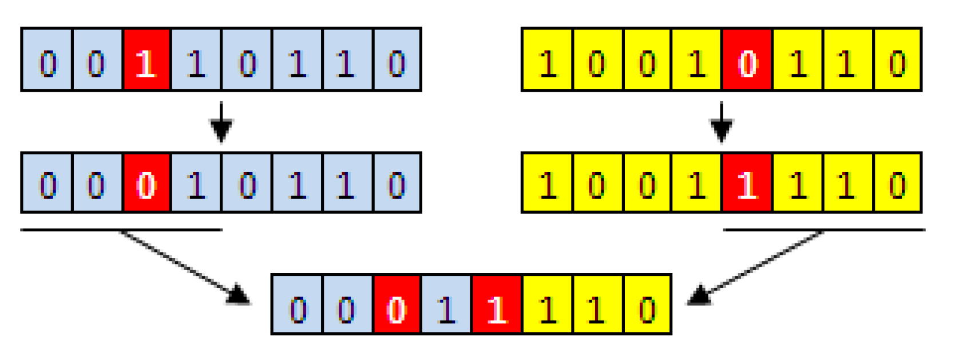
Crossover and Mutation
Notes:
A genetic algrorithm was applied whereby an array was filled with random integers. These acted as weights against a set of heuristics (playing strategies).
The weights are genes and the arrays are the chromasomes.
Hundreds of chromasomes played against each other.
The fittest chromasome was takend out.
A random selection of 10 more chromasomes was taken out of the orginal amount and made to play a tournament.
The best chromasome/array from the tournament was
crossed-over with the fittest chromasome.
The genes/intergers in the new array was randomely mutated.
This was put back into a new pool of randomly allocated chromasomes.
The process/ the generation started again.
Java
Stopping Citeria

Slide 9
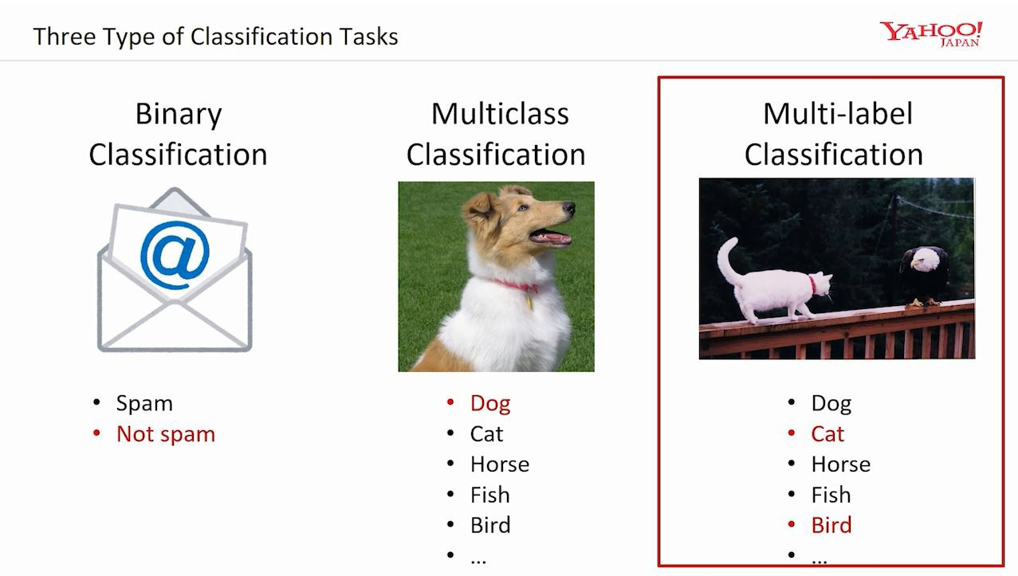
Project - Multi-Class Text Classification
Logistic regression gives useful probabilities for binary-class problems.
spam / not-spam
click / not-click
What about multi-class problems?
apple, banana, car, cardiologist, ..., walk sign, zebra, zoo
red, orange, yellow, green, blue, indigo, violet
animal, vegetable, mineral
Notes:
Why
Organisation has multiple disparate suppliers
Inaccurate understanding of spend
Unable to take advantage of economies of scale
Goal: Create a continuous model classifying suppliers
So...they have a list of supplier names and a set of industry classifications (stationers, banks, insurance, takeaways). They want to allocate each suuplier to teh correct classification.
Data Preparation
Names of suppliers in excel
Taxonomy of 350 classifications
Scrape description of each supplier.
Take out stop words.
TD-IDF – Term Frequency and Inverse Document Frequency - penalise words that appear too frequently
What are the most important unigrams and bigrams? ...in terms of their correlation with the label.
One hot encode the most important unigrams and bigrams
Manually label each supplier description with 350 classification. This is to train and a subset was taken out
for testing.
-----------------------------------------------------------------

Slide 10
Correlations
from sklearn.feature_selection import chi2 import numpy as np
Which Unigrams/Bigrams are most correlated with each of the 350 labels?
# ‘Bank account or service’: . Most correlated unigrams: . bank . overdraft . Most correlated bigrams: . overdraft fees . checking account | # ‘Consumer Loan’: . Most correlated unigrams: . car . vehicle . Most correlated bigrams: . vehicle xxxx . toyota financial | # ‘Credit card’: . Most correlated unigrams: . citi . card . Most correlated bigrams: . annual fee . credit card
Notes:
here we see an exmaple of unigrams and bi grams being correlated with labels.
In this case, it isnt from the specifci project but a simlar one.

Slide 11
Encoding Text One-Hot TDF-IDF Word Embeddings
[[1. 0. 0. 0. 0.] #can [0. 0. 1. 0. 0.] #i [0. 1. 0. 0. 0.] #eat [0. 0. 0. 0. 1.] #the [0. 0. 0. 1. 0.]] #pizza
Notes:
1. Integer Encoding
As a first step, each unique category value is assigned an integer value.
For example, “Can” is 1, “I” is 2, and “EAT” is 3.
Ordinal realtionships where model can taken advantage of ordering
2. One-Hot Encoding
For categorical variables where no such ordinal relationship exists, the integer encoding is not enough as model assums a natural ordering.
HOW ARE YOU
CAN
1, 0,0
I
0,1,0
EAT
0,0,1

Slide 12
Logistic Regression
(Multinomial) Naive Bayes
Linear Support Vector Machine
Random Forest
Notes:
Mutinomial Naive Bayes is just claculating the probabaility that our unigram, bigram belongs to a certain category.
couple of algorithms are generally preferred for text classification (SVM, Naive Bayes, multinomial regressions).
http://www.cs.cornell.edu/people/tj/publications/joachims_98a.pdf

Slide 13
The vast majority of the predictions end up on the diagonal (predicted label = actual label), where we want them to be. However, there are a number of misclassifications. The reason for misclassification is that a description contains language that suggests that it belongs to more than one class. Pizza Hut is a restaurant, but it is also a takeaway and those are distinct in the 350 taxonomy of business descriptions that we are trying to classify against.
Notes:
The vast majority of the predictions end up on the diagonal (predicted label = actual label), where we want them to be. However, there are a number of misclassifications. The reason for misclassification is that a description contains language that suggests that it belongs to more than one class. Pizza Hut is a restaurant, but it is also a takeaway and those are distinct in the 350 taxonomy of business descriptions that we are trying to classify against.

Slide 14
Demand Forecasting - Pre-processing
SKU | Colour | Order Date | Quantity | Sales Representative
Notes:
SKU - categorical - nominal - product type TShirt, Trousers,
Colour - nominal
Order Date -
sales representative - nominal
Convert into a machine learning problem.
Time(in order but not regaular intervals)
We need to split out each product and create equal intervals and see if their is seasonabiity/pattern for each indidvidual product.
We can extract features from date as as day, week, month, year.
Could the quantity order of a particular product be an indicator in future time periods. Should it be lagged.
We can correlated the quantity ordered with various lagged quantity order to see if their is any relavant
or we can take a window of average values of a period of time in history...
or we can weight the more recent values.
Type colour combination
type on its own.

Slide 15
Project Employee Turnover
Attrition - Company does not fill position
Turnover - Company does fill position
Notes:
Employee Attrition. Microsft Talent has this information or any HR operations platform.
Can we sell them a product as add on to ERP/Talent Implementation.
Gender - age distribution by gender, income by gendar, gender by dept
Income - by dept, attribution by overtime.
working enviroment - median salary by job role, attrition by job role
Data Science Process- objective, data understanding, data prepartion, modelling, evaluation....
Will theperson leave based on
department, distance from home, eduction, gendar, income, age, compensation increases, , years worked, years with current manager....mant others...
Classification model
CONCLUSION
People leave based on age - retire - attrition.
Income
Lack of overtime
Manager

Slide 16
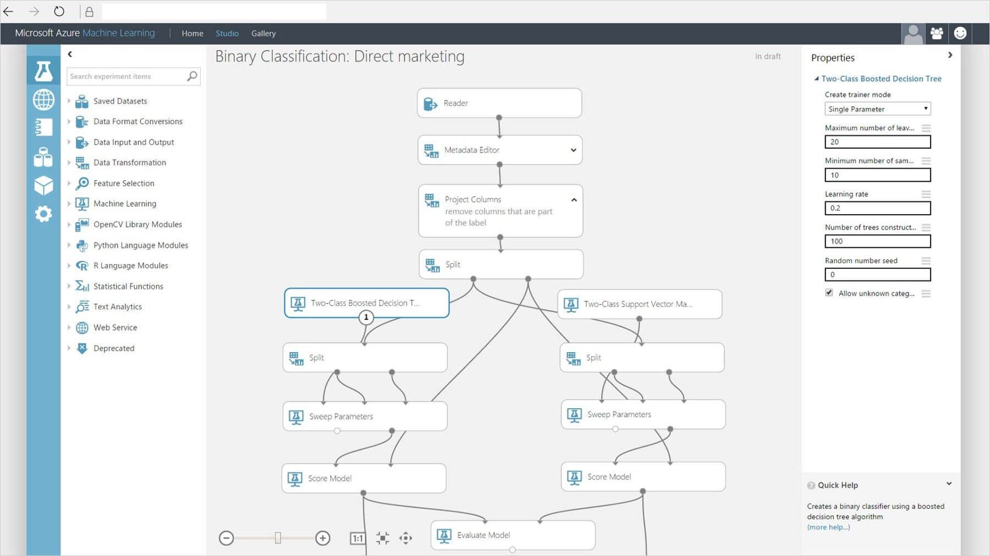
Azure ML Studio Training Course
Notes:
Win new Business.
Classification of Credit Data.

Slide 17
Project - Automatic Review Analyser
Review | Label
Nasty No flavor. The candy is just red, No flavor. Just plan and chewy. I would never buy them again | -1
YUMMY! You would never guess that they're sugar-free and it's so great that you can eat them pretty much guilt free! i was so impressed that i've ordered some for myself (w dark chocolate) to take to the office. These are just EXCELLENT! | 1
Two documents - “Mary loves apples” “Red apples”
dictionary - {Mary; loves; apples; red}
“Mary loves apples” = (1;1;1;0)
“Red apples” = (0;0;1;1)
Notes:
Bag or words by compiling all the words that appear in a training set of reviews into a dictionary
transform each of the reviews into a feature vector of length base on whether a word
in the review appears in the position in the bag of words.
Above Mary, Loves apples appears in dictionary in the order it appears in document but red does not appear in document so encode as 1,1,1,0.
Feature Engineering could be
removing stopwords or you could use bigrams as well as unigrams
Perceptron algorithm - two-class classification problems

Slide 18
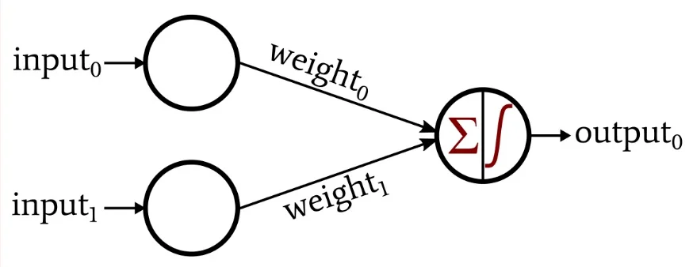
Perceptron
Notes:
Perceptron receives input signals from examples of training data that we weight and combined in a linear equation called the activation.
activation = sum(weight_i * x_i) + bias
The activation is then transformed into an output value or prediction using a transfer function, such as the step transfer function.
prediction = 1.0 if activation >= 0.0 else 0.0
It is closely related to linear regression and logistic regression that make predictions in a similar way (e.g. a weighted sum of inputs).
The way this optimization algorithm works is that each training instance is shown to the model one at a time. The model makes a prediction for a training instance, the error is calculated and the model is updated in order to reduce the error for the next prediction.
This procedure can be used to find the set of weights in a model that result in the smallest error for the model on the training data.
For the Perceptron algorithm, each iteration the weights (w) are updated using the equation:
w = w + learning_rate * (expected - predicted) * x
Where w is weight being optimized, learning_rate is a learning rate that you must configure (e.g. 0.01), (expected – predicted) is the prediction error for the model on the training data attributed to the weight and x is the input value.

Slide 19
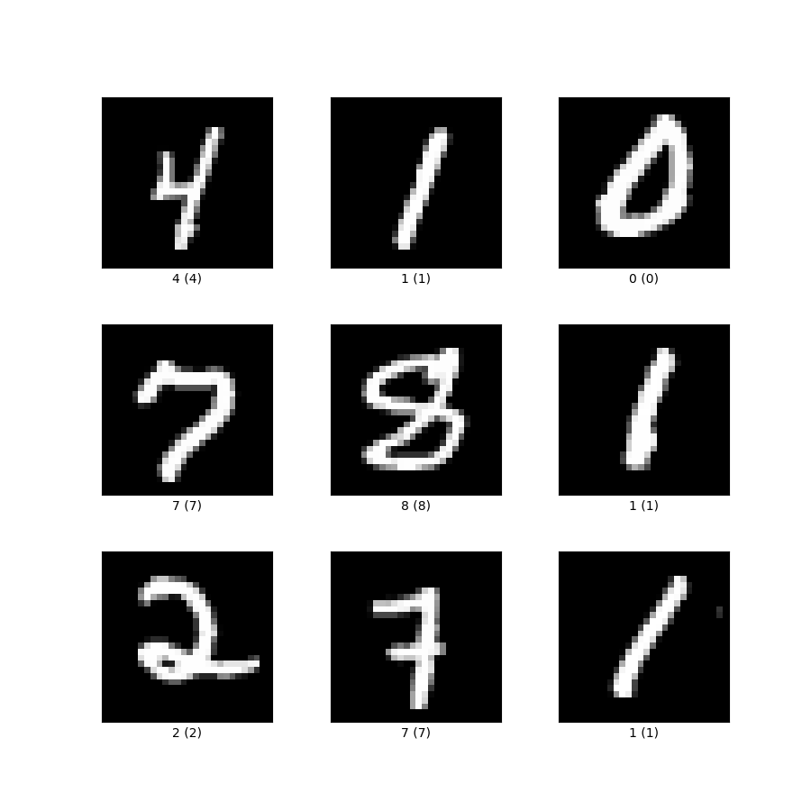
Project - MNIST Images of Digits
Notes:
A matrix of the training data. Each row of train_x contains the features of one image, which are simply the raw pixel values flattened out into a vector of length . The pixel values are float values between 0 and 1 (0 stands for black, 1 for white, and various shades of gray in-between).
multiclass SVM with a one-vs-rest strategy
softmax regression - more than one class.(probabilty of being a member of a certain class)
PCA - centre the data on orgin by substracting the mean and get the sum of teh quare distances from the project point to the origin
We want the most important data in our dataset that represents the maority of the spread or variance - e.g. 99%
1/ What data is of value
2/ maximise the spread of the datat on axis
3/ minimise the errror of each data point
4/ Keep on finding the axis = same as orginal number of dimensions - which are orthognal to the previous
5/scale the data so centre it on zero
6/ covariance matrix which calculates eigenvalues and eigen vectors
7/ we want 99% if the variance explained.
Model should perform nearly as well when only given 18 numbers encoding each image as compared to the 784 in the original data (error on the test set using PCA features should be around 0.15). This is because PCA ensures these 18 feature values capture the maximal amount of variation from the original 784-dimensional data.
STILL NEED To STUDY
Kernel methods owe their name to the use of kernel functions, which enable them to operate in a high-dimensional, implicit feature space without ever computing the coordinates of the data in that space, but rather by simply computing the inner products between the images of all pairs of data in the feature space. This operation is often computationally cheaper than the explicit computation of the coordinates. This approach is called the "kernel trick".[1] Kernel functions have been introduced for sequence data, graphs, text, images, as well as vectors.

Slide 20
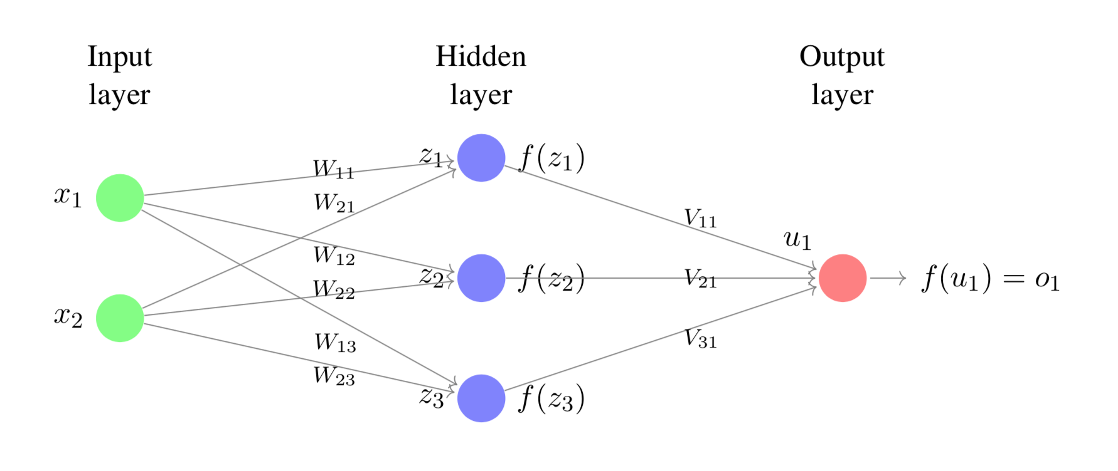
Project - MNIST images of Digits
Notes:
simple input, weight, activation
deep - more than 1 hidden layer
input * weight pass through an actuvation function (linear, or non linear(relu), non linear smoothed(tanh).
HE VALUE OF THE HIDDEN LAYER
It gives us a transformation of the input signal
into a representation that makes the problem easier to solve.
Backpropagation - output versus expected. = Loss. Nudge the weights to reduce the loss.
-----------------------------------------------
Recurrent Neural Networks - predicting sequequencys images, objects, events
e.g. currency forecast with previous values as input vector
e.g. one hot encode previous words in a sentence and use that to predict what comes next in teh sentence.
BUT how far back should we go, what is the important information.
OPTION TO
encode whole sentence- label would be -1(sentiment), next word, translation to different language.

